Slide 1
CS580K – Advanced Topics in Cloud Computing
Term Project (Fall 2018)
Exploring Microservices, Container, and Container Orchestration
- Nehal Pawar (B00719535)
- Shriram Suryawanshi (B00734421)

Slide 2
M
icroservices
otivation
Explore, understand and study the ways with benefits and what is it that made docker kubernetes the replacement of monolithic architecture basically answering why and how of microservices.

Slide 3
Overview
A quick introduction to the web app we are deploying
How to create a Kubernetes cluster on Google Container Engine
Deploying containers and Pods using Replication Controllers
Testing the functionality of Replication Controllers
Deploying Services to facilitate load balancing
Testing the functionality of Services

Slide 4
Application Architecture
Application –
Take the input in DOT language, which is plain text graph description language
Graphviz application - a powerful open source graph layout and visualization tool

Slide 5
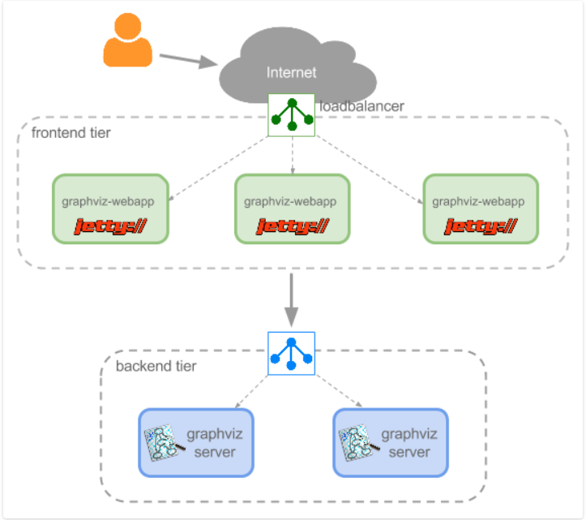
Application Architecture
Two layers – frontend and backend
The cluster has three frontend containers running the Jetty server with a simple web application
The cluster also has two backend containers that run a simple HTTP server and have the Graphviz application installed
Load-balancer & Replication Controllers

Slide 6
Why Kubernetes
Benefits -
Automate the deployment and replication of containers
Scale in or out containers on the fly
Organize containers in groups and provide load balancing between them
Easily roll out new versions of application containers
Provide container resilience, if a container dies it gets replaced, etc.
Need in our project
Load-balance
Cannot suffer failure

Slide 7
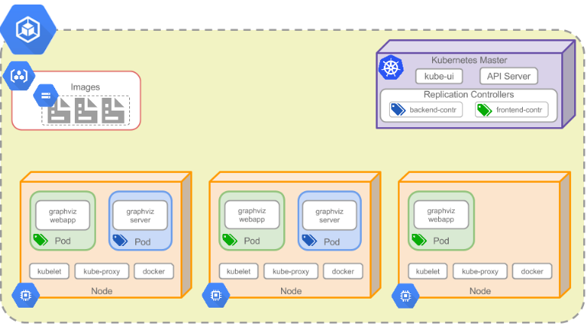
Deployment
Create Cluster
That has 3 nodes and a kubernetes master that is controlled by Kubernetes Engine
Create Frontend
With 3 replica servlet which serves the HTML to client RENDER GRAPH button
Create Backend
With 2 replica that will generate the graph

Slide 8
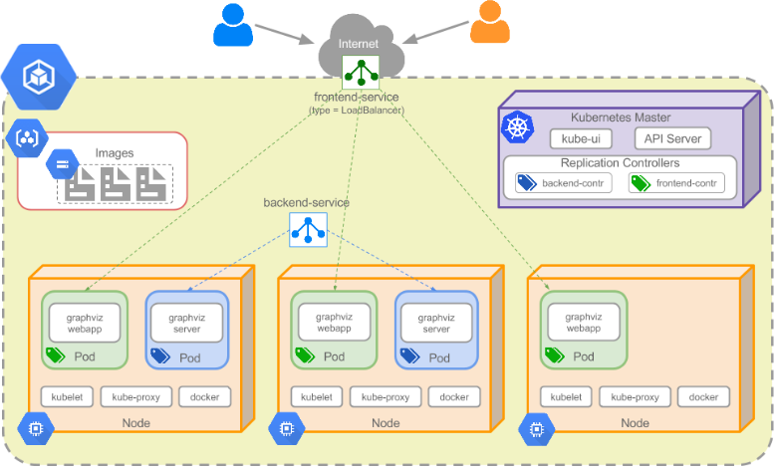
Services
Frontend Service
Type- loadbalancer
Backend Service
DNS resolution used by frontend webapp

Slide 9
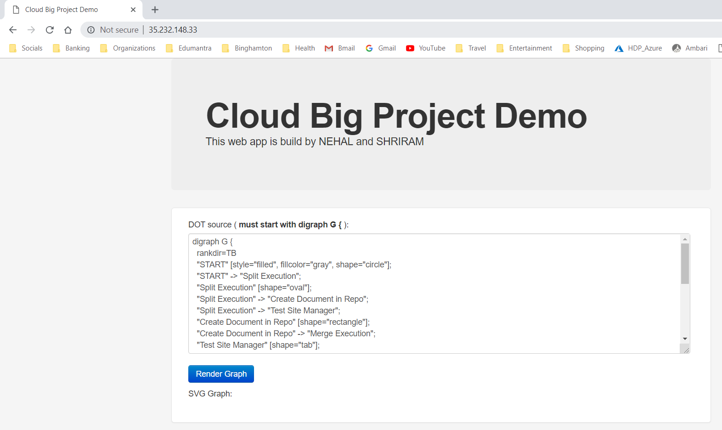
Application
Launch the application with Load Balancer IP address in any browser
Update the graph details in DOT language
Click on Render Graph button

Slide 10
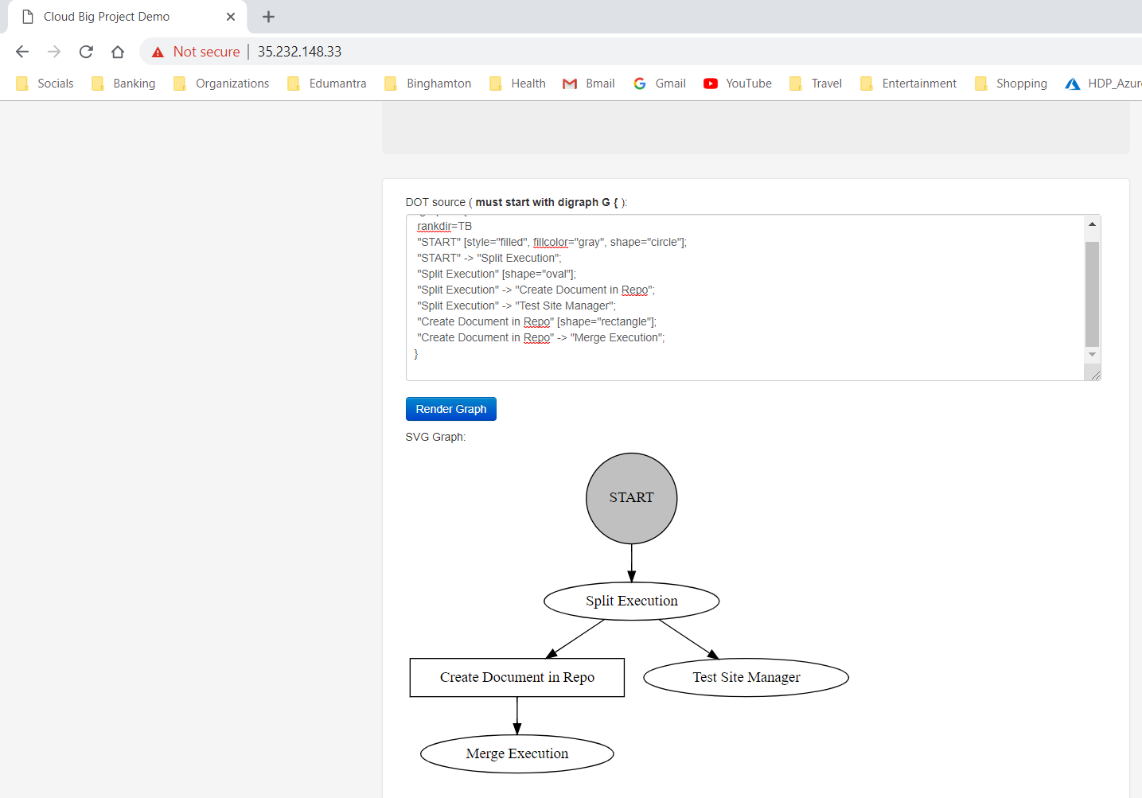
Application
Application generates the graph -

Slide 11
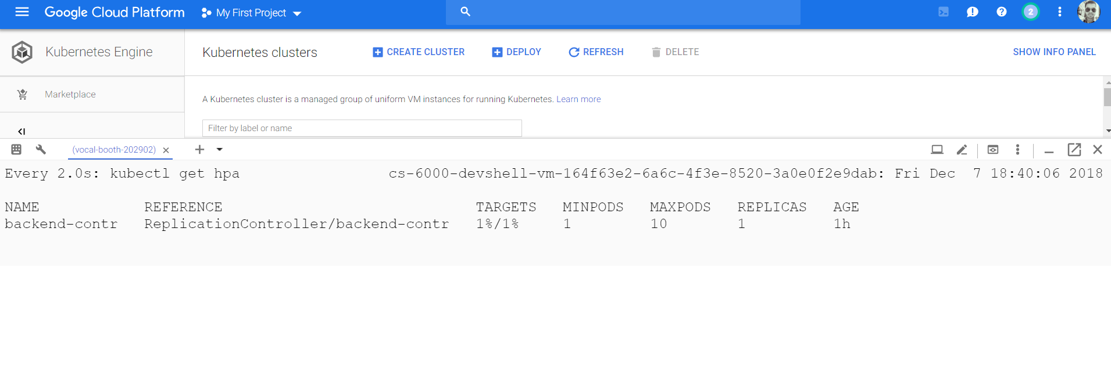
Autoscaling and Load-Balancing
Initial Stage – CPU utilization set to max 1% to test auto scaling

Slide 12
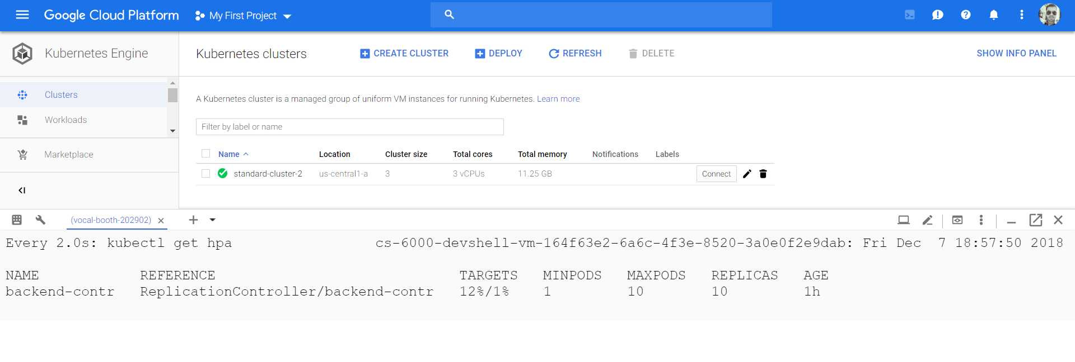
Autoscaling and Load-Balancing
Final Stage – as CPU utilization increases, Kubernetes will create more replicas to handle requests

Slide 13
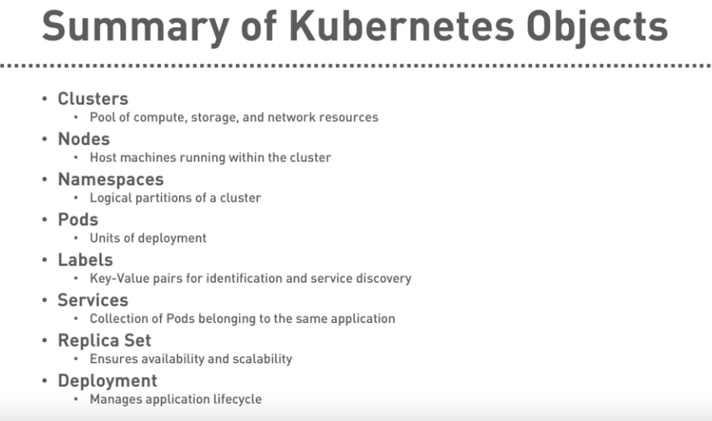

Slide 14
Some YAML file configuration
reference my backend container from a frontend container
Label and selectors
A Label is a key/value pair attached to Pods and convey user-defined attributes.
You can then use Selectors to select Pods with particular Labels and apply Services
Env variable // Kubernetes should resolve the backend-service to an IP Address
urlStr = "http://backend-service/svg";
env: # Environment variables that will be available in the Pod - name: GET_HOSTS_FROM value: dns
Nslookup, resources: Port,Targetport,nodeport
Kube-proxy:in first image is used by Services to proxy connections to Pods

Slide 15
Replication controller work
Test the functionality of the Replication Controller by explicitly killing one of the frontend or backend container

Slide 16
Some Bonus Benefits
Rolling update : easily roll out new versions of application containers
Rolling a Zero-Downtime deployment
we need the new container image
Edit the file .yaml by changing the container image by the new image
After we applied the new deployment, Kubernetes compares the new state with the old one and the deployment can terminate only one pod, and can start only one new pod.
Blue green update
Rolling back to a previous state
kubectl rollout history deployment <Pods Name>
kubectl rollout undo deployment <Pods Name> --to-revision=1

Slide 17
What else have we learned
If Pods are ephemeral how can I persist my container data across container restarts?
Well, Kubernetes supports the concept of Volumes so you can use a Volume type that is persistent.
Implicit Volumes can be mapped to host directory in a Docker container
What if I want it to be universal that is for all ?
Persistent Volumes
VolumeMounts & Volumes in yaml file
Cloud volumes
AWSElasticBlockStore
GCEPersistentDisk
Cinder (OpenStack block storage)

Slide 18
Thank You!

